Slide 1
Requirements engineering
“Requirements engineering is a systematic way of developing requirements through an iterative process of analyzing a problem, documenting the resulting observations, and checking the accuracy of the understanding gained.” – IEEE Standard
Software requirements engineering provides the techniques for:
understanding what a customer wants
analyzing it
assessing feasibility
negotiating a reasonable solution
specifying the solution unambiguously
validating the specification
managing the requirements as they are transformed into an operational system

Slide 2
Roles of requirements
Customers
show what should be delivered; contractual base
Managers
a scheduling / progress indicator
Designers
provide a spec to design
Programmers
list a range of acceptable implementations / output
QA / testers
a basis for testing, validation, verification

Slide 3
Requirements classification
Functional: specify a function that a system or system component must be able to perform
"The user can search either all databases or a subset."
"Every order gets an ID the user can save to account storage.“
Nonfunctional: are not concerned with the functionality of a system but place restrictions on the product
dependability, reusability, portability, scalability, performance, safety
"Our deliverable documents shall conform to the XYZ process."
"The system shall not disclose any personal user information."

Slide 4
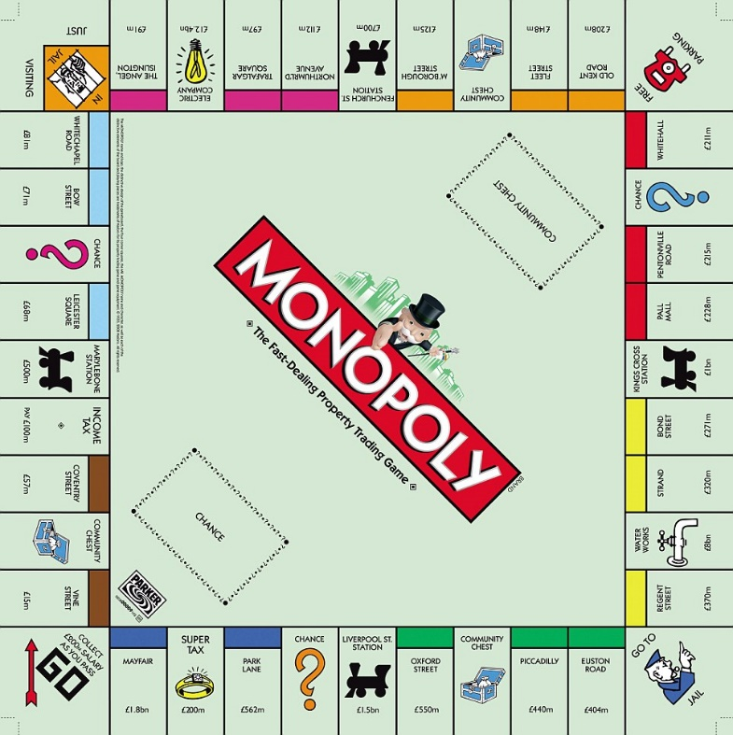
Example: Functional requirement
When a player passes or lands on the Go cell, the player shall get paid $200.
When a player lands on the Free Parking cell, nothing shall happen.
When a player lands on an available property cell, the player shall have a chance to purchase it. The price shall be the land value of that property.

Slide 5
Non-functional requirements
Security:
protection of information and data
unauthorized persons or systems cannot read or modify them
authorized persons or systems are not denied access to them
Privacy: “the right to be let alone.”
Which information can be collected
What must not be stored
Usability: the ease with which a user can
learn to operate
prepare inputs
interpret outputs

Slide 6
Non-functional requirements
Reliability: the ability to perform required functions under stated conditions
Types: low, medium, high
Example: Cell-phone
Call: high reliability
Playing games: low reliability
Availability: the degree to which a system is operational and accessible
99.99% availability
Performance: measures how a system accomplishes its designated functions within given constraints
Speed
Accuracy
Memory usage

Slide 7
Example: Non-functional requirement
The system must conform to ISO/IEC 27034-1:2011 security standard.
An user should receive search results within 0.01 seconds with more than 80% accuracy.
The system must be 100% operational 99.9% of the calendar year during its first year of operation.

Slide 8
Stakeholders
Any person or group who will be affected by the system, directly or indirectly
• Examples
End users
System administrators
Engineers maintaining the system
Business managers

Slide 9
Stakeholders’ viewpoints
Different set of requirements for different types of stakeholders
Interactor viewpoints
People who interact with the system
Indirect viewpoints
People who influence the system’s requirements in some other way
Domain viewpoints
Domain characteristics and constraints

Slide 10
Viewpoints: Bank ATM
Interactor viewpoints
Consumer
Bank manager (policy settings)
People who fill up the ATM
Bank server
Indirect viewpoints
Bank manager (policy settings)
Federal reserve
Thieves or security managers
Domain viewpoints
Laws governing ATM use
Agreements with other banks

Slide 11
How to gather requirements?
Interviews
Talk to the users
Ask questions
Observation
Observe current business activities
How current system works
Examine documents and artifacts
Ideas on automating manual forms
Ask security / privacy policies
Alternate scenarios
Failures

Slide 12
How to gather requirements?
Questionnaire
Clarification questions
Goal / purpose
Prototypes
Paper mock-ups/ screenshots
Static websites
Onsite customer
Working with the requirement team
Brainstorm
Think what users might want

Slide 13
How *NOT* to gather requirements?
• Describe complex business logic or rules of the system.
• Be too specific or detailed.
• Describe the exact user interface used to implement a feature.
• Try to think of everything ahead of time. (You will fail.)
• Add unnecessary features not wanted by the customers

Slide 14
Requirements validation
Concerned with demonstrating that the requirements define the system that the customer really wants.
Requirements error costs are high so validation is very important
Fixing a requirement related error after delivery may cost up to 100 times the cost of fixing an implementation error.

Slide 15
Requirements checking
Validity. Does the system provide the functions which best support the customer’s needs?
Consistency. Are there any requirements conflicts?
Completeness. Are all functions required by the customer included?
Realism. Can the requirements be implemented given available budget and technology
Verifiability. Can the requirements be checked?

Slide 16
Requirements validation techniques
Requirements reviews
Systematic manual analysis of the requirements.
Prototyping
Using an executable model of the system to check requirements.
Test-case generation
Developing tests for requirements to check testability.

Slide 17
Requirements reviews
Regular reviews should be held while the requirements definition is being formulated.
Both client and contractor staff should be involved in reviews.
Reviews may be formal (with completed documents) or informal. Good communications between developers, customers and users can resolve problems at an early stage.

Slide 18
Review checks
Verifiability
Is the requirement realistically testable?
Comprehensibility
Is the requirement properly understood?
Traceability
Is the origin of the requirement clearly stated?
Adaptability
Can the requirement be changed without a large impact on other requirements?

Slide 19
Good or bad requirements?
The system will enforce 8.5% sales tax on Illinois purchases.
The system shall display the elapsed time for the car to make one circuit around the track within 5 seconds, in hh:mm:ss format.
The product will never crash. It will also be secure against hacks.
The server backend will be written using PHP or Ruby on Rails.
The system will support a large number of connections at once, and each user will not experience slowness or lag.
The user can choose a document type from the drop-down list.

